Slide 1
Community Health and Relationships to Leading Causes of Death
Parth Patel
Ana Phan

Slide 2
Dataset: Community Health Status Indicators (CHSI) to Combat Obesity, Heart Disease and Cancer
Data collected by the U.S Department of Health and Human Services to combat health related causes of death such as obesity, heart disease, cancer, physical activity, and smoking.
The data is designed for health care professionals and community members alike to identify behavioral factors that contribute to death in the United States and to be proactive in getting this information out to the general public.

Slide 3
Data Structure
There are over 200 measures for each of the 2,141 United States counties.
The data is distributed across 9 tables. In this project, 3 tables were used:
Demographics - breaks down the country by county, describing race and age
Leading Causes of Death - describes the leading causes of death in each county
Risk Factors and Access to Care - percentage of people taking part in risk related activities (smoking, diabetes, no exercise)

Slide 4
Hypothesis 1
Smoking is a leading risk factor in cancer related deaths.
Cancerous cells are created by damaging our DNA. This can be done in numerous different ways.
Many of the chemicals found in cigarettes have been shown to cause DNA damage, including benzene, polonium-210, benzo(a)pyrene and nitrosamines.
Also found in cigarettes, chromium makes poisons like benzo(a)pyrene stick more strongly to DNA, increasing the chances of serious damage. And chemicals like arsenic and nickel interfere with pathways for repairing damaged DNA.

Slide 5
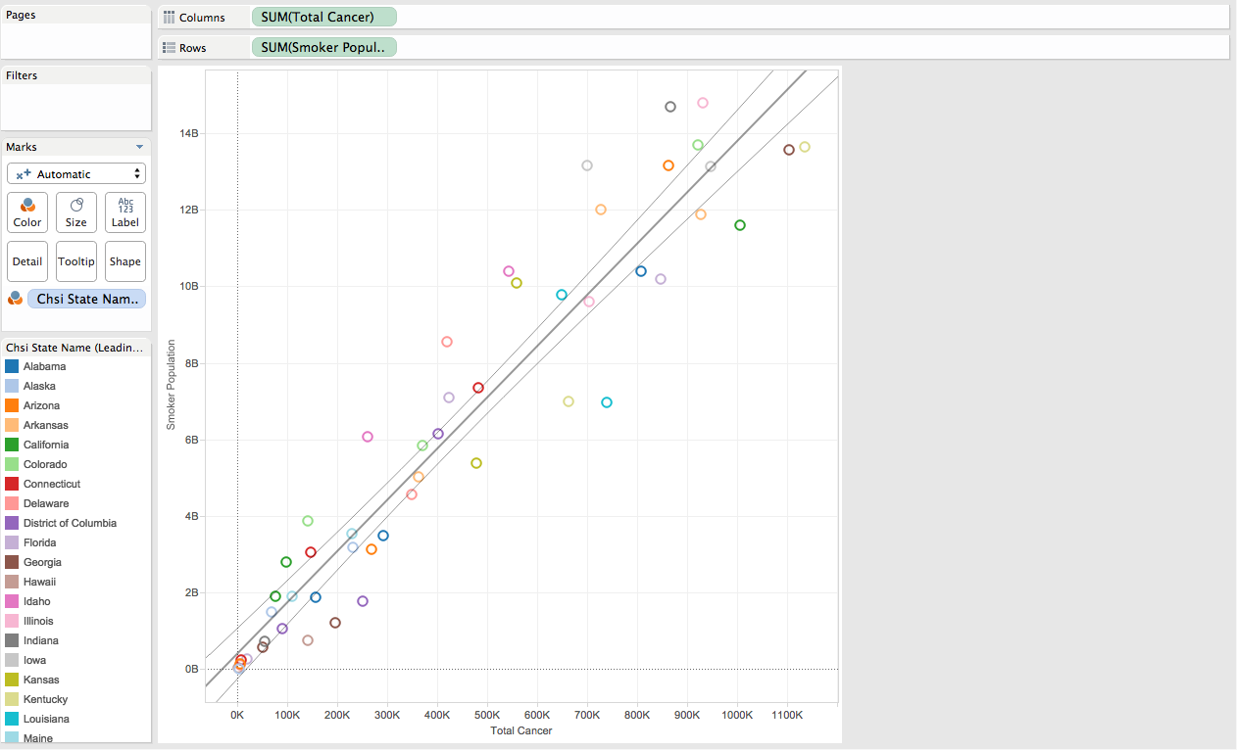
Smoking vs. Cancer
Each county had a percentage of smokers from total population. This was aggregated using a calculated field.
Each county's population was listed in the Demographics table.
Total Cancer was a calculated field summing all fields in the Leading Causes table.
Notes:
The Risk Factor table included percentages for each county. We wanted an actual total but a population was not provided in this table.
The Demographics table provided a total population for each county but there was no single primary key field. for each county.
We decided to join the data sources through the county, state, and county ID. This allowed us to join properly.
The Leading Causes of Death table included the causes of death distributed by race. We created a calculated field and aggregated all races for each county.
We put state in the Color Field, allowing us to produce a visualization with county’s aggregated into their state.

Slide 6
Hypothesis 2
Obesity is a leading health factor in heart disease related deaths.
Heart disease is an umbrella term for diseases related to the heart and blood vessels. Typically heart disease is the buildup of plaque in the walls of our arteries, leading to complications with blood flow.
Our bodies are meant to be lean and thus promote a high metabolism. Weight slows down our metabolism
Increased weight can affect blood pressure by creating artificial pressure from the fat pushing on blood vessels.
This increase in blood pressure can lead to diabetes as it interferes with our ability to use insulin effectively.

Slide 7
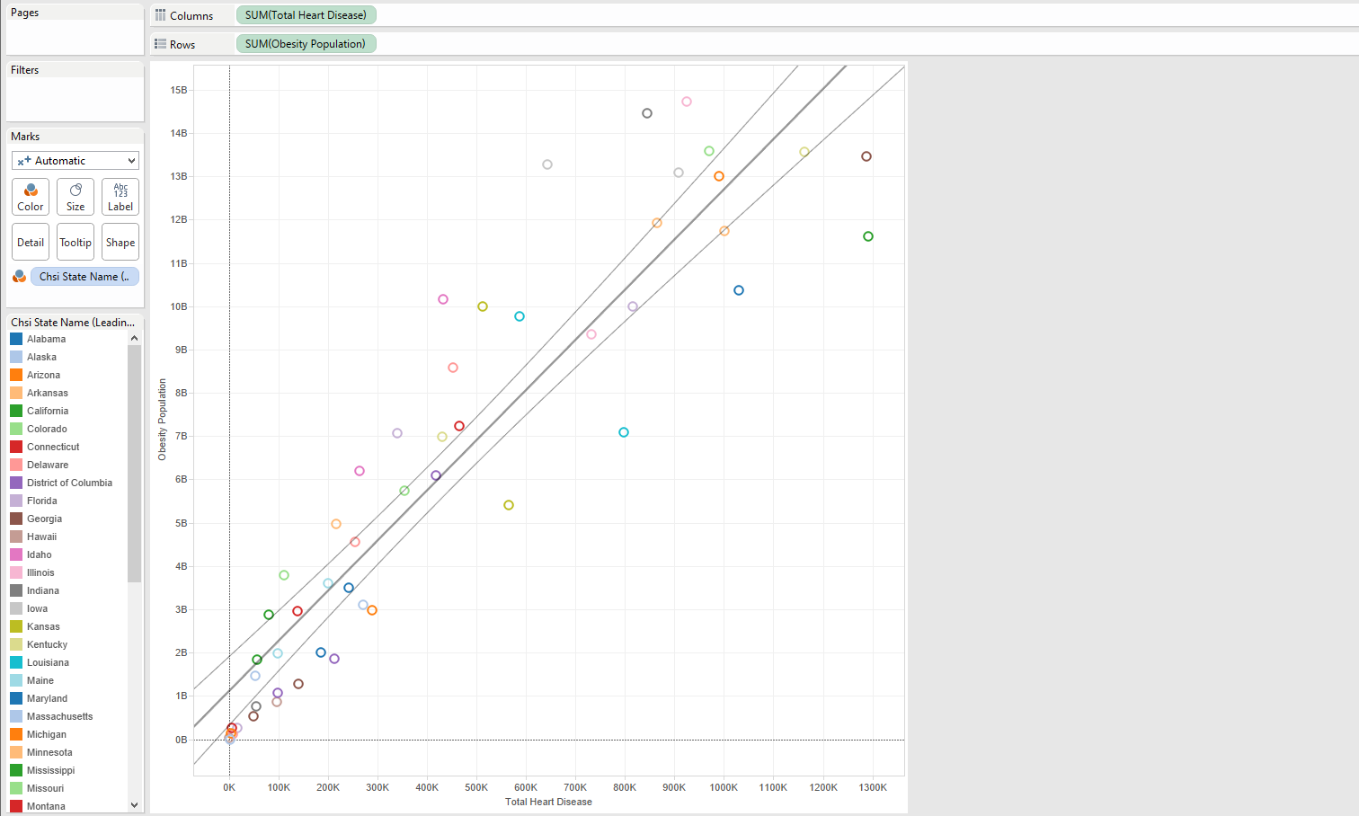
Obesity vs. Heart Disease
Each county had a percentage of obesity from total population. This was aggregated using a calculated field.
Each county's population was listed in the Demographics table.
Total Heart Disease was a calculated field summing all fields in the Leading Causes table.
Notes:
The Risk Factor table included percentages for each county. We wanted an actual total but a population was not provided in this table.
The Demographics table provided a total population for each county but there was no single primary key field. for each county.
We decided to join the data sources through the county, state, and county ID. This allowed us to join properly.
The Leading Causes of Death table included the causes of death distributed by race. We created a calculated field and aggregated all races for each county.
We put state in the Color Field, allowing us to produce a visualization with county’s aggregated into their state.

Slide 8
Hypothesis 3
Diabetes is a leading health factor in heart disease related deaths.
Increased blood sugar can lead to cardiovascular complications.
Insulin resistance can be a factor leading to heart attack. Heart attacks have been listed in this data as Heart Disease

Slide 9
Diabetes vs. Heart Disease
Diabetes is aggregated with population to create a breakdown by state
Total Heart Disease was a calculated field summing all fields in the Leading Causes table.
Notes:
The Demographics table provided a total population for each county but there was no single primary key field. for each county.
We decided to join the data sources through the county, state, and county ID. This allowed us to join properly.
The Leading Causes of Death table included the causes of death distributed by race. We created a calculated field and aggregated all races for each county.
We put state in the Color Field, allowing us to produce a visualization with county’s aggregated into their state.

Slide 10
Hypothesis 4
A high poverty rate is related to a high homicide rate
A study conducted by Robert Lee of the Mississippi State University found a relationship with poverty, race, and homicide.
The issue is a sociological one and not an economic one, according to the study.

Slide 11
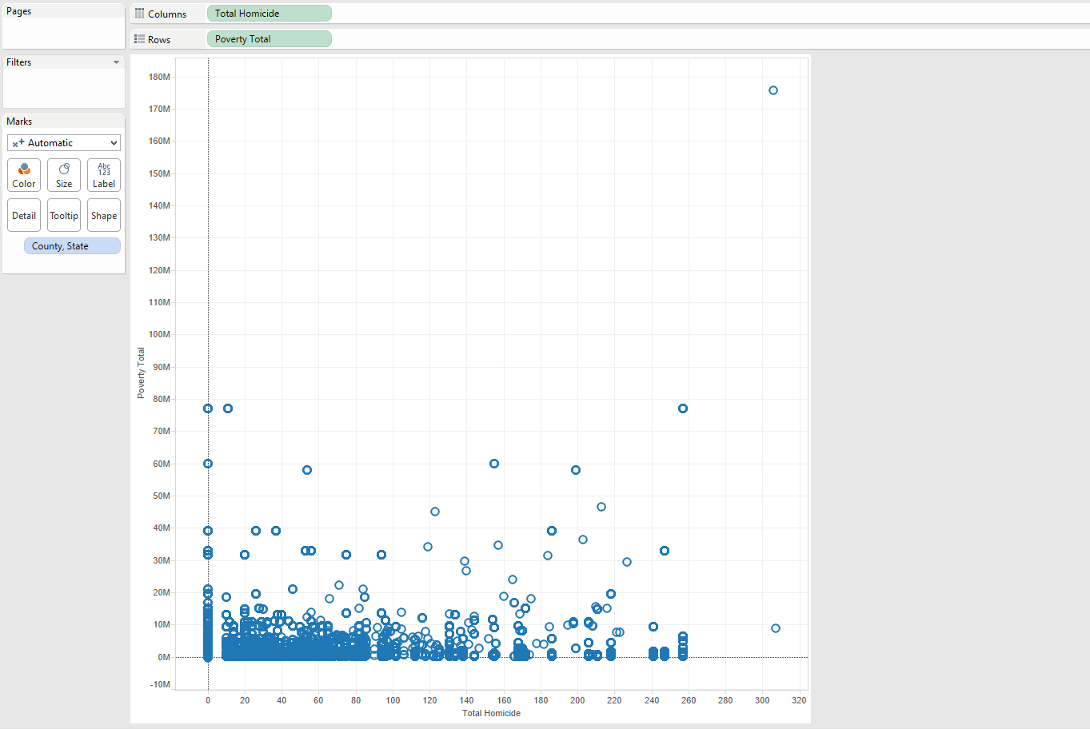
Poverty vs. Homicide
A new View was created in SQL Developer to create a unique identifier for each county.
Los Angeles County looks to have a high rate of both poverty and homicide.
the hypothesis does not seem to apply elsewhere for the most part.

Slide 12
Conclusion
Smoking is bad.
Obesity can lead to a number of complications. Stay healthy!
Poverty does not seem to have a relationship with homicide.

